Slide 1
Module 7 - Modal VERBS + REFLEXIVE PRONOUNS + HAD BETTER
Caterina Ines Latella

Slide 2
INDEX
- MODAL VERBS
- REFLEXIVE PRONOUNS
- HAD BETTER

Slide 3
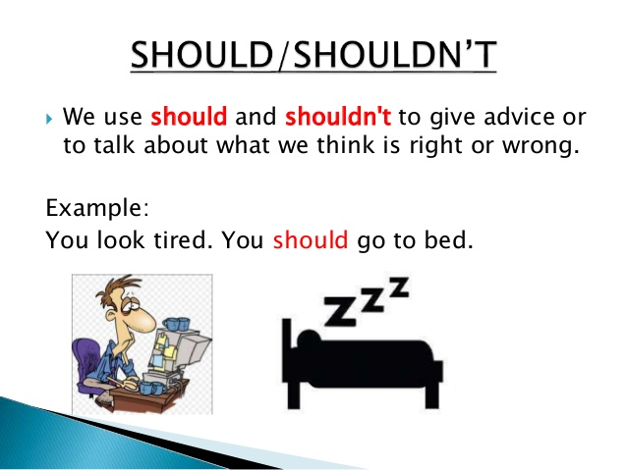
GIVING ADVICE/SUGGESTIONS
We use should for:
• Polite suggestions or offers of help
“Should I make a list for you?”
• Giving advice
  “When you travel you should pack lightly”
• Predictions or expectations that something will happen
  “The director should be here in a minute”

Slide 4
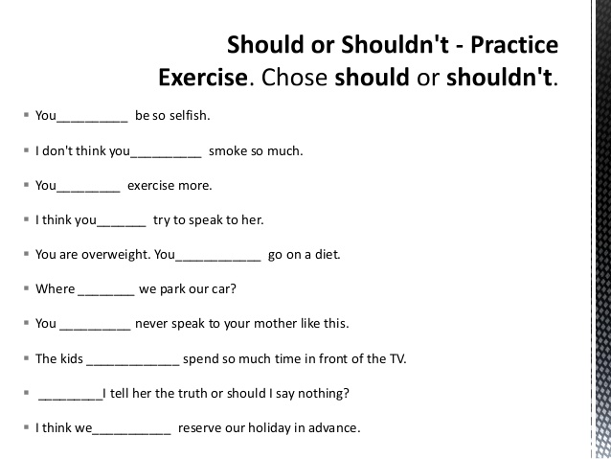
practice

Slide 5

MUST /mʌst/ - MUSTN’T /mʌs^{ə}nt/
We use MUST for:
• Obligation and future intention Ex. “I must finish packing soon”
• Strong necessity Ex. “He must take his medicine”
• Persuading someone to do something Ex. “You must let me do the laundry. You’ll be late”
• Certainty because of facts Ex. “Jane isn’t here. Her plane must be late”
We use MUSTN’T:
• to say that something is forbidden or prohibited.
Ex. “You mustn’t put liquids in your carry-on”

Slide 6
CAN /CAN’T+ INFINITVE
We use can for:
• Ability “I can speak 3 foreign languages”
• Possibility “You can’t come tomorrow, I have to work”
• Requests or asking for permission “Can I use your computer?”
• Offers of help “How can I help you?”
• Giving permission “You can use my dishes”

Slide 7
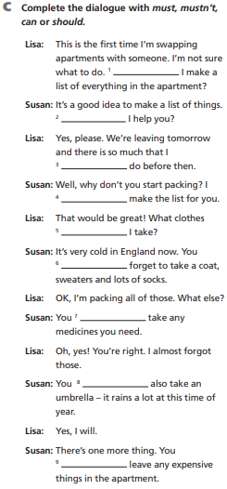
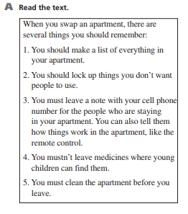
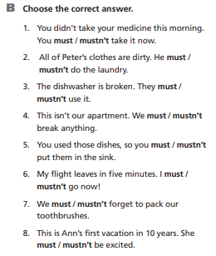
PRACTICE

Slide 8
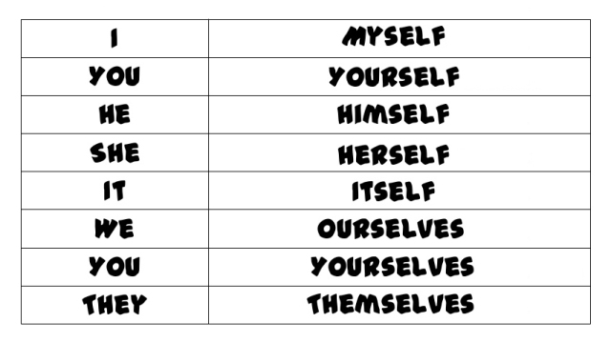
REFLEXIVE PRONOUNS

Slide 9
REFLEXIVE PRONOUNS
We use reflexive pronouns:
– when the object and subject of a sentence are the same.
He taught himself how to cook.
– to emphasize the subject.
I carried the suitcases myself. (I carried them, and not someone else.)
• We use by + a reflexive pronoun to talk about something the subjects did alone.
They fixed the car by themselves. (No one helped them)

Slide 10
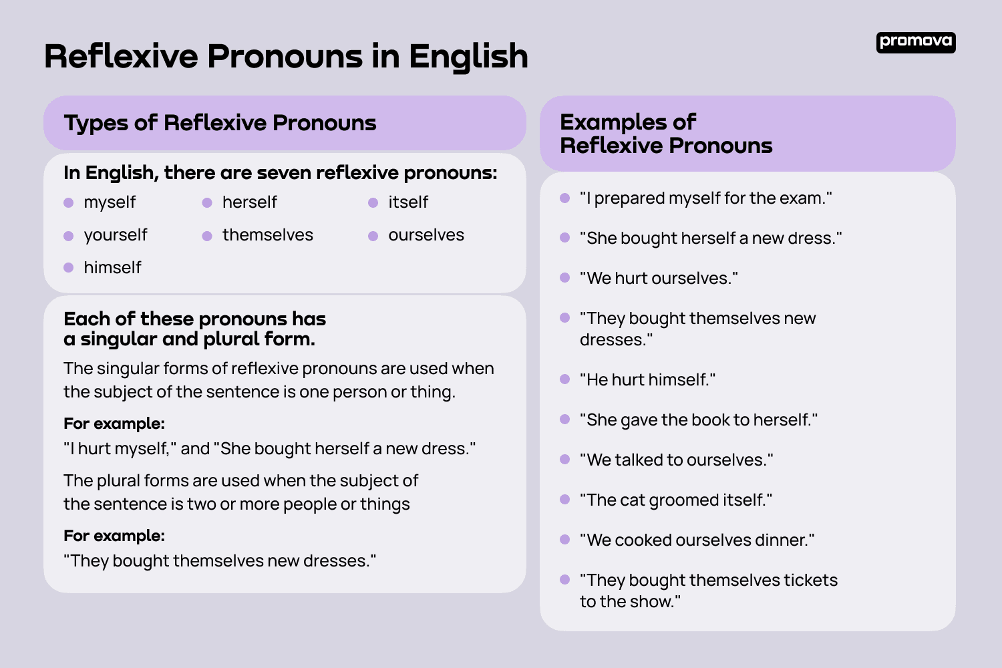
REFLEXIVE PRONOUNS

Slide 11
HAD BETTER
We use had better for giving advice or warning, or to point out the wise or correct thing to do.
You had better see a doctor. (advice)
She had better not be late. (warning)
We had better get to the airport early. (wise thing to do)
Note: We don’t usually use had better in questions.
Positive Subjetc + had (’d) better + base form of the verb.
Negative Subject + had (’d) better not + base form of the verb.

Slide 12

HAD BETTER - exmples
EX. 1 I had better buy some shampoo. (I need to wash my hair. I don’t have any more shampoo, etc.)
Ex. 2 He had better not be late. (He has an important meeting. School starts soon, etc.)
Ex. 3 We had better go shopping for a gift. (It’s someone’s birthday, etc.)
Speaking - Try to come up with situations in which someone might say: had better/had better not + infinitive

Slide 13
Keep practicing
https://www.englisch-hilfen.de/en/exercises/modals/must_not.htm
https://www.tolearnenglish.com/exercises/exercise-english-2/exercise-english-82380.php
https://elt.oup.com/student/solutions/elementary/grammar/grammar_05_022e?cc=ro&selLanguage=en
https://elt.oup.com/student/result/engint/a_grammar/unit01/1b_1?cc=ro&selLanguage=en

Slide 14

THANK YOU FOR YOUR attention

